Slide 1
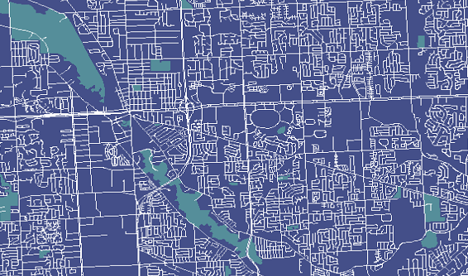
Home
Groesbeck Corridor Redevelopment: GIS Provides Site Selection Tool in Collaboration with Local Communities
Crime Incident Web Mapping Giving Sheriff Office’s & The Public More Insights
Shop Small in Macomb County
About
Projects & Maps
GIS Portal
GIS User Group
Contact
First Meeting of GIS User Groups: 1/1
Second Meeting: 4/1
GIS (Geographic Information Systems) is a unit of Macomb County’s Planning & Economic Development Department, but serves the entire County GIS enterprise, all levels of government, the public, and various stakeholders. The primary mission of Macomb County’s GIS is to manage geospatial data, online maps, applications and the architecture to support them. This data and applications are used for analysis to improve decision making and enhance the quality of life for all in Macomb County.

Slide 2
Home
Macomb County GIS
About
Projects & Maps
GIS stands for Geographic Information Systems and is a powerful tool to manage data, especially spatial data. Macomb County’s GIS Services maintains a variety of data, maps, and applications related to infrastructure, planning & land use, environmental, economic development, and quality of life.
GIS Portal
GIS User Group
Contact
Infrastructure
Planning & Land Use
Environmental
Economic
Quality of Life
Location and information about fundamental facilities that are managed by a variety of government entities and are needed to support the county.
Data on the variety of different urban planning strategies and land use classifications, to regulate and plan the development of land within the county.
Tracked facts about the management and status of natural resources, which is vital to support growth and a healthy environment for the whole county.
Information on the county’s economic health, related to businesses economic investments, job creation, and industry growth.
Factors that affects the health, comfort, happiness, and general quality of life experienced by all of the people or groups in the county.

Slide 3
Home
Macomb County GIS
About
Projects & Maps
Recent Projects & Maps
GIS Portal
GIS User Group
Contact
Browse Other Maps & Data
Infrastructure
Planning & Land Use
Environmental
Economic
Quality of Life

Slide 4
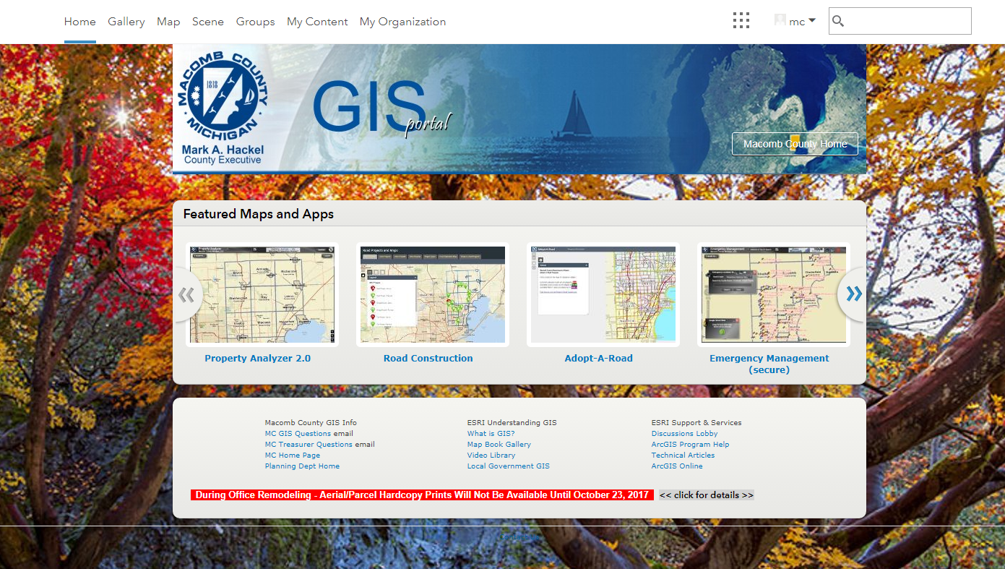
Home
Macomb County GIS
About
Projects & Maps
This online portal is where Macomb County’s GIS hosts data, maps, and applications for the County enterprise and public to use and analyze. Macomb County’s GIS is in collaboration with ESRI and other agencies to support web content infrastructure and interfaces. If you would like to request to data or additional access to the portal? Email: Planning@MacombGov.Org.
Portal: GIS.MacombGov.Org.
GIS Portal
GIS User Group
Contact

Slide 5
Home
Macomb County GIS
About
Projects & Maps
In the beginning of 2018 Macomb County’s GIS will be starting a GIS User Group for anyone that uses the County’s GIS portal / data or just uses GIS in general. The topics will be a variety of components of GIS and allow users to share their successes (tips and tricks) and to discuss the most recent trends in local government, the state of Michigan, and the geospatial community.
Register for the next user group here: Google Form
Questions? Email: Planning@MacombGov.Org
GIS Portal
GIS User Group
Contact

Slide 6
Home
Macomb County GIS
About
Projects & Maps
Jeff Schroeder
Program Manager
- Best Boss Award
- MVP of GIS
Email:
Jeff.Schroeder@MacombGov.Org
Dan Durkee
Project Coordinator
- Database Wizard
- Coder & Hacker
Email:
Jeff.Schroeder@MacombGov.Org
GIS Portal
This is the core staff of Macomb County’s GIS unit under the Planning & Economic Development Department. The overview provides a little description of each persons main focus and the email for the staff.
If you have a general question, comment, or concern?
Email: Planning@MacombGov.Org
GIS User Group
Contact
Kim Wolosiewicz
GIS Specialist
- Land Use & Parcels
- Cartography Master
Email:
Jeff.Schroeder@MacombGov.Org
Jessica Worley
GIS Specialist
- Web Development
- Millennial Minded
Email:
Jeff.Schroeder@MacombGov.Org

